Slide 1
Lending Loan Case Study
Atharv Ganla
Nikhil Mothkuri

Slide 2

Agenda
Data Analysis
Data Cleansing
Univariate and Segmented Univariate analysis
Bivariate and multi variate analysis
Conclusion

Slide 3
Introduction
The loan dataset is provided for past and existing customers. As Learners we have to understand and analyse the data to provide substantial evidence on the factors which can play a major role in delinquency of loans and those loans which are most likely not be paid fully.

Slide 4
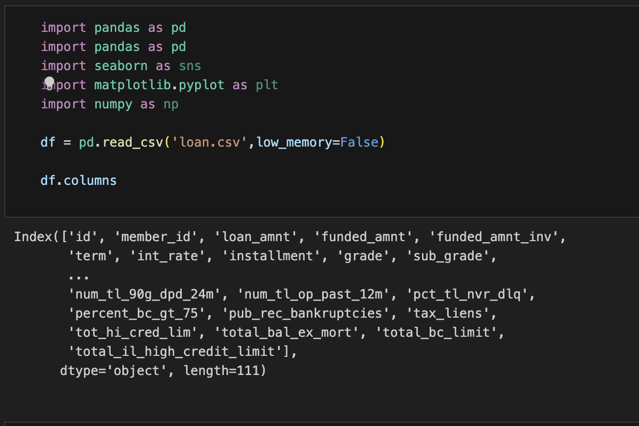
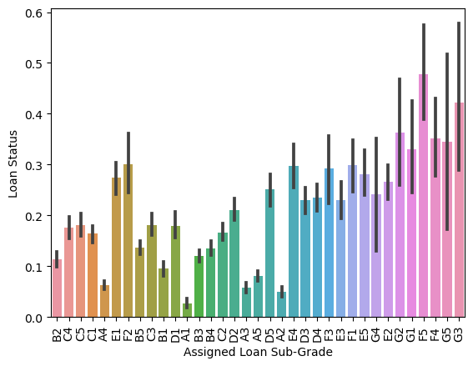
Data Analysis
Data Identification and Cleansing

Slide 5
Data Identification and Cleansing
1. A total of 39717 rows and 111 columns are present in the dataframe.
2. There are 54 columns with all the rows having null values.
3. There are 9 columns with only one single value in it.
4. There are columns with a lot of null values and only with few distinct values.
5. A total of 47 columns have been renamed.
6. 7 columns have been cleansed from objects to strings and int/float.

Slide 6
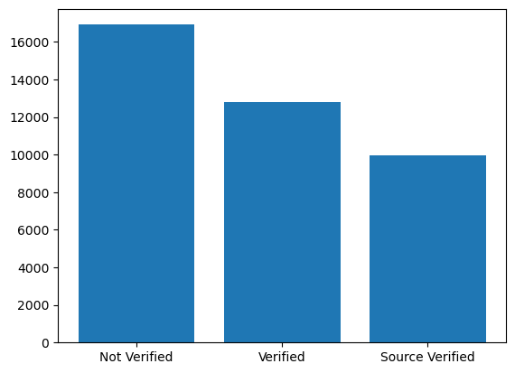
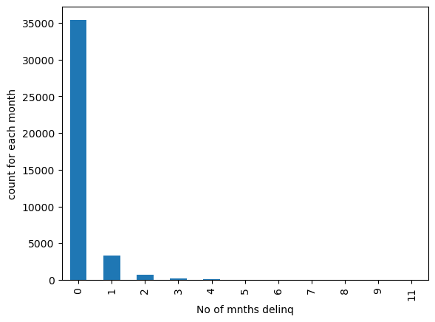
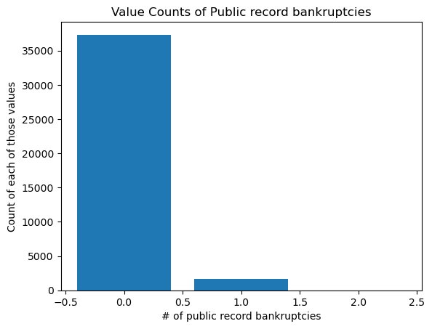
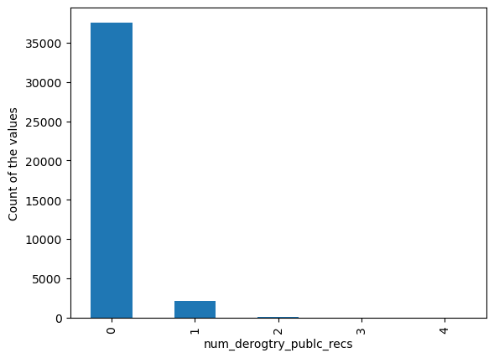
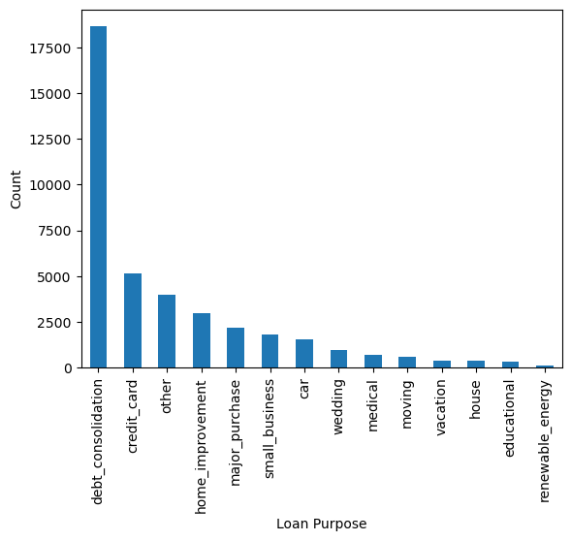
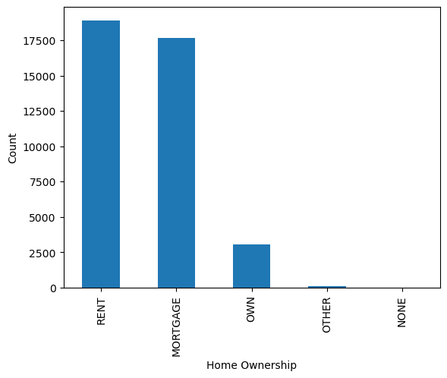
Univariate analysis of some of the columns
Univariate analysis is the analysis of columns in isolation.
Univariate analysis of all the columns revealed that there are values that are significantly higher in specific columns.

Slide 7
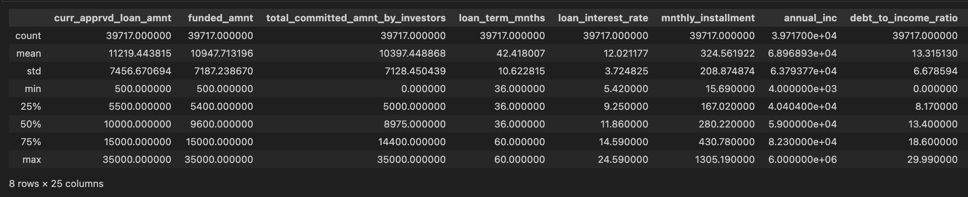
Univariate analysis of some of the columns
The univariate analysis revealed interesting insights between the following columns.
Interest rate ( min – 5.42, max – 24.59, heavier above mean )
Grade ( A to G )
sub grade ( Again subgrade by numbers )
income source verification status ( Not verified, verified, Source Verified )
Loan purpose ( debt –consolidation – higher, credit card and other – medium, renewable –lower )
Loan status ( Fully Paid, Current and Charged Off – needed for segmented and bivariate )
Employment length in years ( Values between 0 to 10+ years, most loans given at 4 years )
Home ownership ( Most values for Rent, Mortgage driving the ownership )
Debt to Income Ratio ( Most of the values above the mean value )
2. These are some of the values among other values that we did analysis on using
DataFrame.describe() which can found in the jupyter notebook

Slide 8
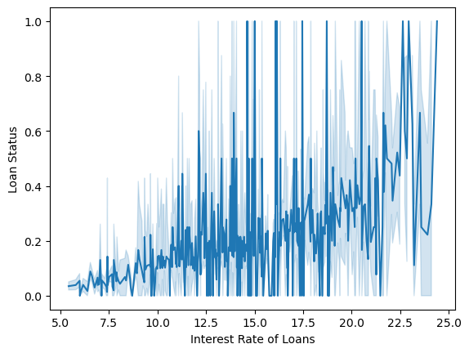
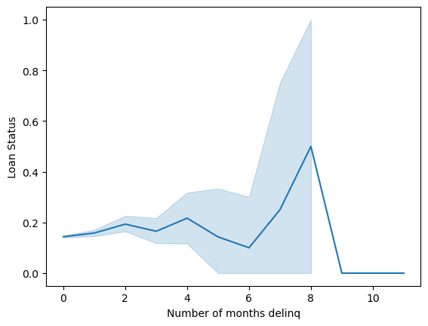
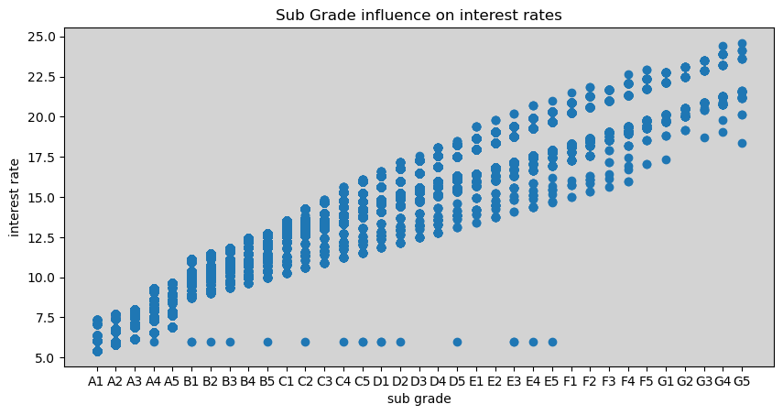
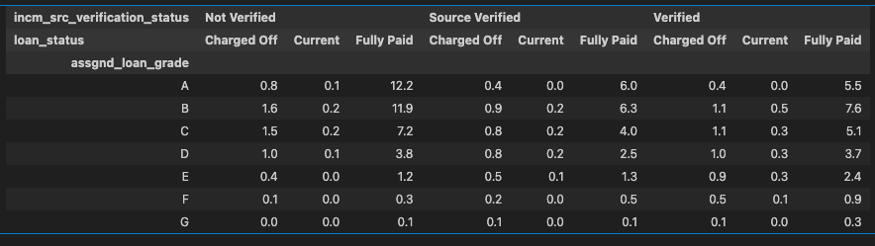
Univariate segmented analysis of some of the columns
Segmented univariate analysis is trying to establish a relationship between a single column and another column while segmenting it.
We have given some relationships that are established between columns

Slide 9




Walt Disney
The way to get started is to quit talking and begin doing.

Slide 10
Univariate segmented analysis of some of the columns
Segmented univariate analysis is trying to establish a relationship between a single column and another column while segmenting it.
We have given some relationships that are established between columns

Slide 11
Univariate segmented analysis of some of the columns
The interest rate seems to be higher for the loans when we move from current loans to charged off loans
The number of 30+ months delinq in the last 2 years have between 8 and 10 as we move towards Charged Off loans

Slide 12
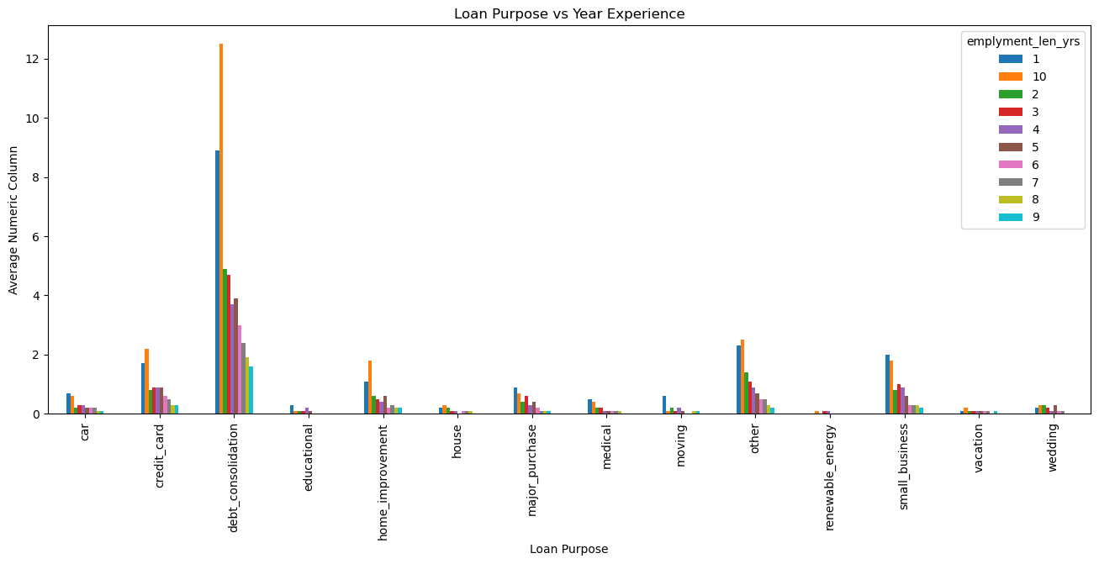
Univariate segmented analysis of some of the columns
The interest rates which have higher rate of interest tend to have more Charged Off loans.
The loan purpose and number of years of experience has a definite relationship. Debt consolidation tops the list with credit card and other come next but with lesser significance

Slide 13





Team
Name
Name
Name
Name
Name
Title
Title
Title
Title
Title

Slide 14
Timeline
To start a presentation, go to the Slide Show tab, and select From Beginning.
01
To display Presenter view, in Slide Show view, on the control bar at the bottom left select the three dots, and then Show Presenter View.
02
During your presentation, the speaker notes are visible on your monitor, but aren't visible to the audience.
03
The Notes pane is a box that appears below each slide. Tap it to add notes.
04
If you don’t see the Notes pane or it is completely minimised, click Notes on the task bar across the bottom of the PowerPoint window.
05

Slide 15
Content
Subtitle
Subtitle
Add text, images, art, and videos.
Add transitions, animations, and motion.
Save to OneDrive, to get to your presentations from your computer, tablet, or phone.
Open the Design Ideas pane for instant slide makeovers.
When we have design ideas, we’ll show them to you right there.

Slide 16
Additional content
Subtitle
Subtitle
Subtitle
Add text, images, art, and videos.
Add transitions, animations, and motion.
Save to OneDrive, to get to your presentations from your computer, tablet, or phone.
Open the Design Ideas pane for instant slide makeovers.
When we have design ideas, we’ll show them to you right there.
This PowerPoint theme uses its own unique set of colours, fonts, and effects to create the overall look and feel of these slides.
PowerPoint has tons of themes to give your presentation just the right personality.

Slide 17



Summary
With PowerPoint, you can create presentations and share your work with others, wherever they are. Type the text you want here to get started. You can also add images, art, and videos on this template. Save to OneDrive and access your presentations from your computer, tablet, or phone.

Slide 18
Thank you
Presenter name
Email address
Website

